Slide 1
Lecture 2: Modules, Applications, and Errors
CS-546 – Web Programming

Slide 2
Structure of a Node App

Slide 3
What is a Node app?
Throughout the term, you will be building a number of applications in Node.
Ultimately, you can view a node app as a series of scripts that are run together.
A web application, for example, would have the following scripts
A script that, when run, listens on port 3000 for HTTP requests to retrieve data
A second script that runs as a background process and researches information to add to the databases
A third script that analyzes newly researched information and creates statistics on the new data

Slide 4
What makes an app?
Generally, your application will have the following structure in this course;
Project folder
package.json; describes the application, and its dependencies
node_modules/; stores all the dependencies
app.js; initializes and runs a server, or whatnot
views/
static/

Slide 5
package.json
The package.json is a very important file that stores information about your project, such as:
Name
Repository
License Type
List of dependencies
List of developer dependencies
Author
Scripts
When starting a project, navigate to your folder and use the npm init command to interactively create the start of that file.
When submitting assignments in this course, you must submit the package.json file and include the author field with your name.

Slide 6
Dependencies
It would be very difficult to reinvent every component of an application, every time you start coding.
Node allows authors to publish their code online on Github or on NPM (Node Package Manager); anyone can then download their code through the npm application and install it as a dependency towards a project.
References to these dependencies can be saved to your package.json file.
Dependencies are exposed in the form of modules.
You can install dependencies with the following command:
npm install PACKAGENAME --save
You must include --save to save it to your package.json file
Points will be deducted if you do not save all your dependencies.

Slide 7
The Scripts Object
Your package.json command contains a field, “scripts”, that is an object containing different script tasks. For each key in the scripts object, you would have a value that contains the command for running each script (as if from the terminal).
https://docs.npmjs.com/cli/run-script
For example, you could have a script for testing your code, and running your app, like so:
“scripts”: {
“start”: “node app.js”,
“test”: “node test.js”
}
You can run the test command by running npm run test.
The start command can be run with npm run start, or the shorthand version, npm start.

Slide 8
What are packages and npm?
Node has a massive repository of published code that you can very easily pull into your assignments (where applicable) through the node package manager (npm).
You will require the modules that your packages export, and use code that other people have created, tested, and tried. You will then use these packages to expand on your own applications and build out fully functional applications.

Slide 9
Installing the app
Node runs off of a series of dependencies, which are managed through the package manager, NPM
When download a node application, you will be downloading it without dependencies, so you must install them on download
npm install
Dependencies are stored in the node_modules folder
When you submit an assignment, you must submit it without the node_modules folder
Points will be deducted if you submit the node_modules folder

Slide 10
Running the app
Once your dependencies are installed, you can start your app with the npm start command.
The npm start command will run the start script from the scripts object in the package.json file.

Slide 11
Setting up your application
When setting up an application, you will do the following steps:
Make a new folder for the application
Run npm init and go through the walkthrough
Open package.json and update the “scripts” section and add a property of:
"start": "node app.js”
Where app.js is the name of the file you want to run on start
Install your dependencies and save them to the package
npm install PACKAGENAME --save
Write some code in your starting file
Run app with npm start
See package.json for Lecture-2 Code for example
https://github.com/Stevens-CS546/CS-546/blob/master/Lecture%20Code/lecture_02/calculator_app_example/package.json

Slide 12
Modules

Slide 13
What is a module?
Generally, a module is an individual unit that can be plugged into another system or codebase with relative ease. Modules do not have to be related, allowing you to write a system that allows many different things to interact with each other by writing code that glues them all together.
They are very flexible, and allow you to organize your code very well!
In Node.js, you will be using modules everywhere. In our case, a module will be a specific object (think, an instance of a class) that has certain methods and data that you can access from other scripts. You will create your first module today.

Slide 14
Using Git to get today’s code
By this point, you should have also installed git. Git is a version control software, that you should be able to use via your command line. As part of this course, you will be learning how to version control your software.
Through your command line, issue the following command:
git clone https://github.com/Stevens-CS546/CS-546.git
By cloning this repository (a codebase with a version history) you will make a local copy of the code in a folder called CS-546
Navigate into this folder, so that you may run the following node scripts together.

Slide 15
Require
There is a special, global function called require, which will allow you to import code from other files, packages, etc.
When you require a file / package, you will be accessing whatever the programmer assigned to be exported in that file. From there, you can use the code.
This allows you to make very small, isolated code that performs related functions.

Slide 16
How do I make my code ‘requirable’?
There is another global variable called module, which has a property called exports on it.
When you require a file / package, it will take whatever is assigned to the module.exports variable in a package. You can export anything you want: a function, a number, or an object that allows you to do any combination of these things.
You can see an example of this in the calculator_module_example/calculator.js and calculator_module_example/app.js files.
You can use those files in order to get started making your own modules!

Slide 17
Why would I use modules?
The more unrelated code you have together, the messier your application will become and the harder it will be to maintain.
You can have accidental name collisions
It becomes harder to follow what the related components are in a large file
It becomes less readable overall
Modules allow for many great things:
You can strictly define what code is exported to be used, allowing you to make entire files with a defined structure
You can change the internal workings of a module to make it more performant and add more features while not updating external code.

Slide 18
Error Checking Module Methods

Slide 19
Error Checking
Modules are intended to be fundamentally nuclear, and should be designed to act alone. One of the most important aspects of this nuclear design is that each method exported in a module should have full error checking for that.
You should make sure each method checks that the arguments passed are valid in many ways:
Check that arguments are provided (check if undefined)
Check that arguments are of the expected type (use typeof operator)
https://developer.mozilla.org/en-US/docs/Web/JavaScript/Reference/Operators/typeof
Check that arguments are within proper bounds (i.e., if you are writing a division method, make sure that you cannot divide by 0)

Slide 20
Throwing
When a method is given bad inputs, to prevent the method from running, you want to use the throw operator to stop execution of the current function with a user defined exception.
In JavaScript, you can throw any type. You can throw strings, numbers, booleans, objects, errors, or anything else.
https://developer.mozilla.org/en-US/docs/Web/JavaScript/Reference/Statements/throw
By default, native JavaScript methods will throw an object that is an instance of the Error object.
https://developer.mozilla.org/en-US/docs/Web/JavaScript/Reference/Global_Objects/Error

Slide 21
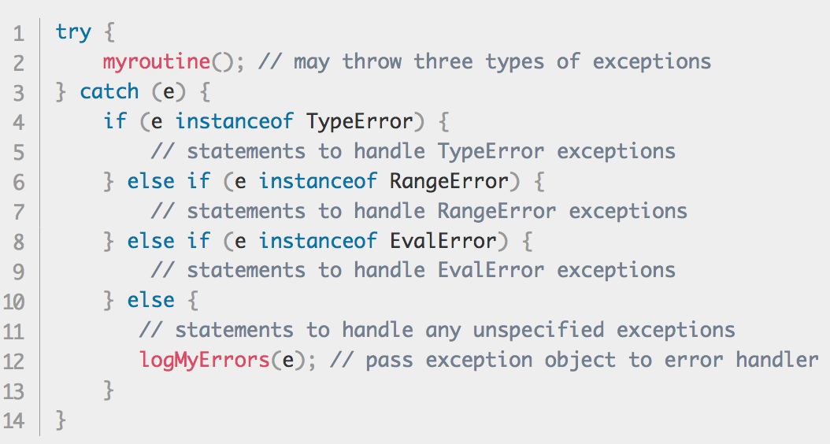
Catching Errors
You can catch errors by surrounding the methods that you call in try / catch blocks.
https://developer.mozilla.org/en-US/docs/Web/JavaScript/Reference/Statements/try...catch
You do not want to catch the errors inside of your methods (unless your method can recover from errors).
A recoverable error inside your method would be catching a failed file-save operation, catching that error, checking if it was because the filename was already in use, and changing over to save to a new filename.
You would not want to catch the errors that you throw from your method, otherwise the developer running your code would never be able to tell that an error occurred.
You can catch particular error types by using the instanceof operator inside your catch statement.

Slide 22
Making custom errors
While you can throw any data type, you may find it useful for your method to throw different types of errors for different exceptions
You can make an ArgumentError for when your method is passed invalid arguments.
To make a custom error, you would extend the Error object with custom data so that you can check that particular type of error.
https://developer.mozilla.org/en-US/docs/Web/JavaScript/Reference/Global_Objects/Error#Custom_Error_Types

Slide 23
Making a Calculator Module

Slide 24
The goal of your module
The goal of your module is simple: take numbers and perform a basic numerical operation on them.
The module should not concern itself with things like getting user input, but it should concern itself with arguments that are valid.
You can see an example of a calculator module on our code for this week
https://github.com/Stevens-CS546/CS-546/blob/master/Lecture%20Code/lecture_02/calculator_module_example/calculator.js

Slide 25
Errors to Check For
addTwoNumbers(first, second)
Check that you are provided with 2 numbers
subtractTwoNumbers(first, second)
Check that you are provided with 2 numbers
multiplyTwoNumbers(first, second)
Check that you are provided with 2 numbers
divideTwoNumbers(numerator, denominator)
Check that you are provided with 2 numbers
Check that denominator is not 0

Slide 26
Exporting Methods
You export methods by attaching properties to the exports / module.exports global object.
When you require this file, you will be given a copy of this object.
https://github.com/Stevens-CS546/CS-546/blob/master/Lecture%20Code/lecture_02/calculator_module_example/calculator.js
https://github.com/Stevens-CS546/CS-546/blob/master/Lecture%20Code/lecture_02/calculator_module_example/app.js

Slide 27
Writing a quick test driver
You can require your module by using a relative path in the require function:
const calc = require(‘./calculator.js’)
You can then test it by using exported methods.
https://github.com/Stevens-CS546/CS-546/blob/master/Lecture%20Code/lecture_02/calculator_module_example/app.js

Slide 28
Making a Calculator App

Slide 29
Bringing it all together
We can now go through the following steps together:
Make a new folder
Create a file, app.js
Run npm init and go through the instructions
Use app.js as your entrance point
When done, install the prompt package
npm install prompt --save
Require your module in app.js
Require prompt
Begin creating your application!
Run your app when ready
npm start

Slide 30
Using prompt
Many packages we use this term will require you to read a little documentation.
The prompt package is a simple package that allows you to easily get information from the terminal
https://www.npmjs.com/package/prompt
You may find the types example on their Github repository very helpful
https://github.com/flatiron/prompt/blob/master/examples/types.js

Slide 31
Questions?

